Slide 1
What is a chunk?
Barbara Oakley, PhD, PE

Slide 2
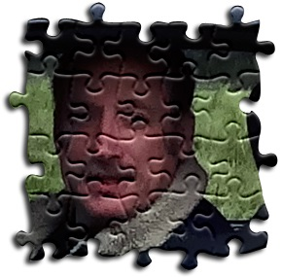



Slide 3
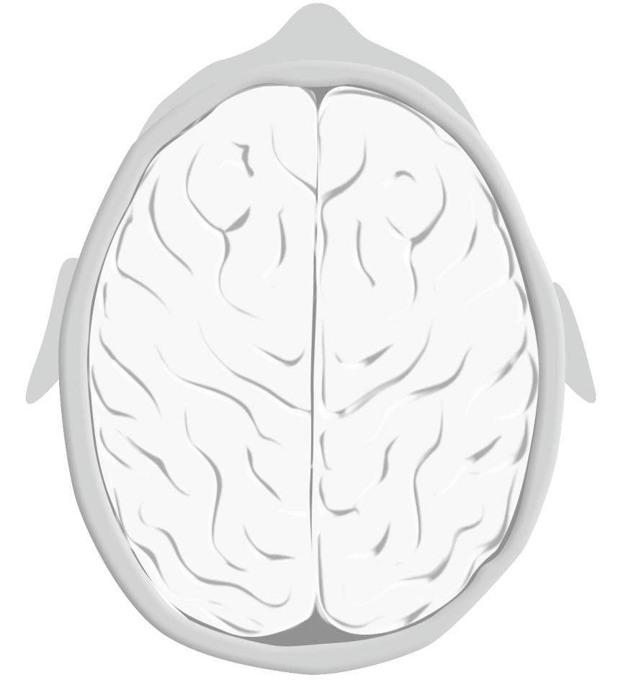

Slide 4
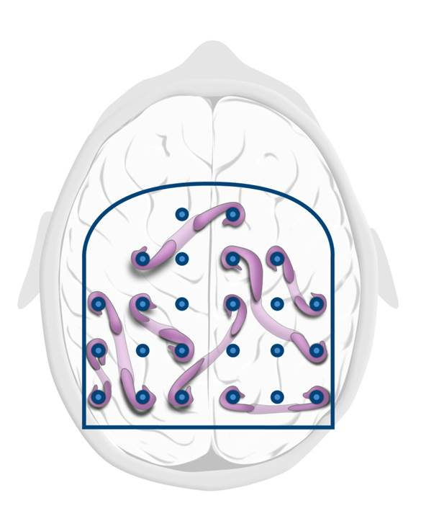

Slide 5
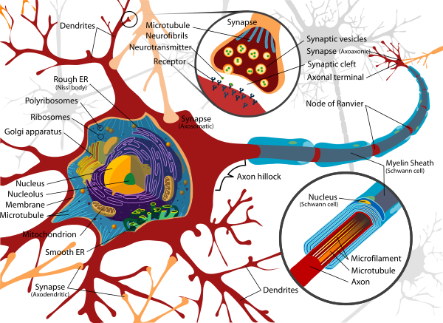
__ __ __
(write the letters here that appear
on the screen….)

Slide 6

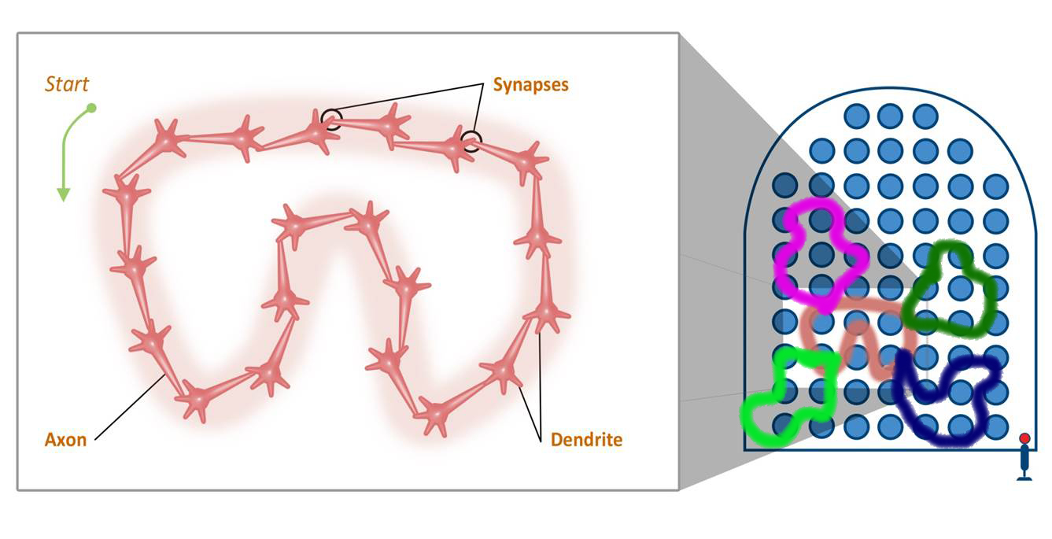

Slide 7



Slide 8
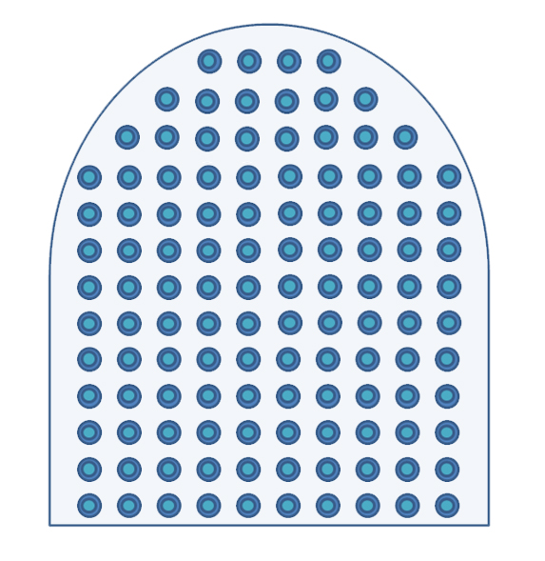

Slide 9
Relevant Readings
Beilock, S. (2010). Choke. NY: Free Press.
Ericsson, K. A. (2009). Development of Professional Expertise. NY: Cambridge University Press.
Gobet, F., & Clarkson, G. (2004). Chunks in expert memory: Evidence for the magical number four… or is it two? Memory, 12(6), 732-747.
Gobet, F., Lane, P. C. R., Croker, S., Cheng, P. C. H., Jones, G., Oliver, I., & Pine, J. M. (2001). Chunking mechanisms in human learning. Trends in Cognitive Sciences, 5(6), 236-243.
Guida, A., Gobet, F., Tardieu, H., & Nicolas, S. (2012). How chunks, long-term working memory and templates offer a cognitive explanation for neuroimaging data on expertise acquisition: A two-stage framework. Brain and Cognition, 79(3), 221-244. doi: 10.1016/j.bandc.2012.01.010
Nyhus, E., & Curran, T. (2010). Functional role of gamma and theta oscillations in episodic memory. Neuroscience and Biobehavioral Reviews, 34(7), 1023-1035. doi: 10.1016/j.neubiorev.2009.12.014
Image Credits
Neurons image http://en.wikipedia.org/wiki/Neuron
4 slots of working memory and cerebral cortex © Kevin Mendez and Barbara Oakley, 2014
Defense Language Institute logo, http://en.wikipedia.org/wiki/Defense_Language_Institute
Octopus of attention and diffuse tentacles, images © Kevin Mendez, 2014
Pinball images © Kevin Mendez and Barbara Oakley, 2014
Puzzle images © Kevin Mendez and Philip Oakley, 2014
Neurons firing together © Kevin Mendez, 2014
Clip art courtesy Microsoft Corporation
Music Credits
Ashley Hall free music http://www.ashleyhallmusic.com/MP3/Lead_Kindly_Light.mp3

